Slide 1


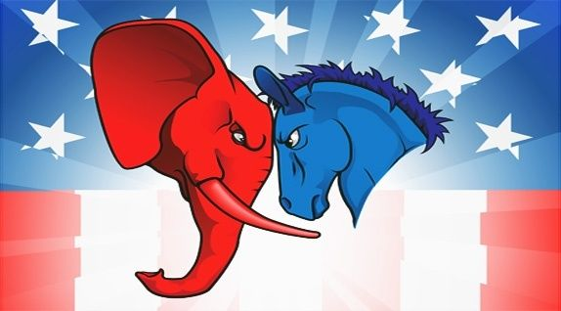
Mini-Project 3 – Party Loyalties
By Jack Sticklen

Slide 2

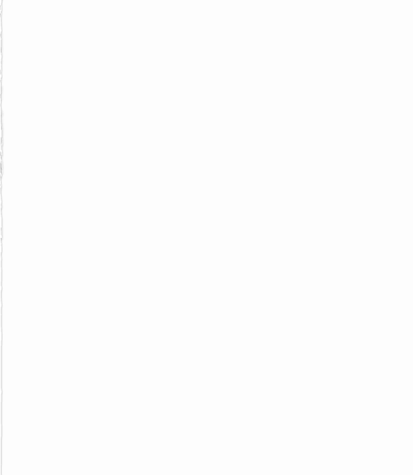

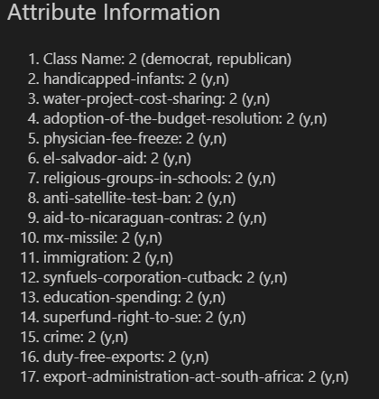
THE DATA
Pulled from the UCI Repository
Includes votes for 16 KEY pieces of legislation – US Congress in one quarter of 1984
Simplified into Yes, No, and abstentions

Slide 3
THE PROBLEM: Can we use machine learning techniques to identify who belongs to which party?

Slide 4
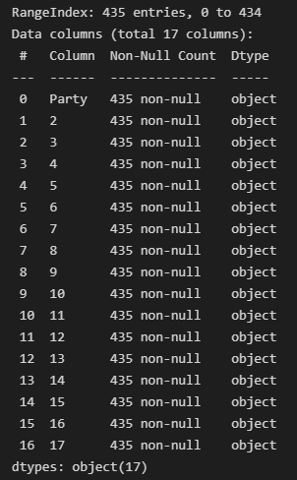
Reading and cleaning
Put data into dataframe
Check for datatypes and null values
As seen on left – no null values, but each column needs to be put into a form that’s better for modelling

Slide 5

Treat data
Converted all columns to dummy variables
Beyond this ignored outliers (binary data)

Slide 6
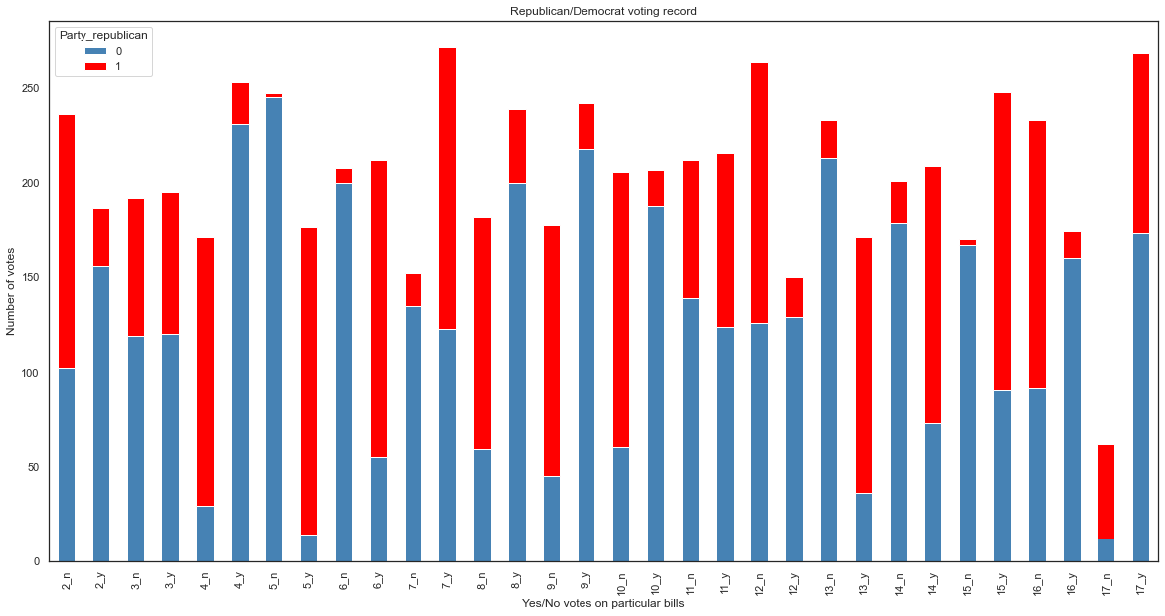
Visualise – Stacked Plots

Slide 7
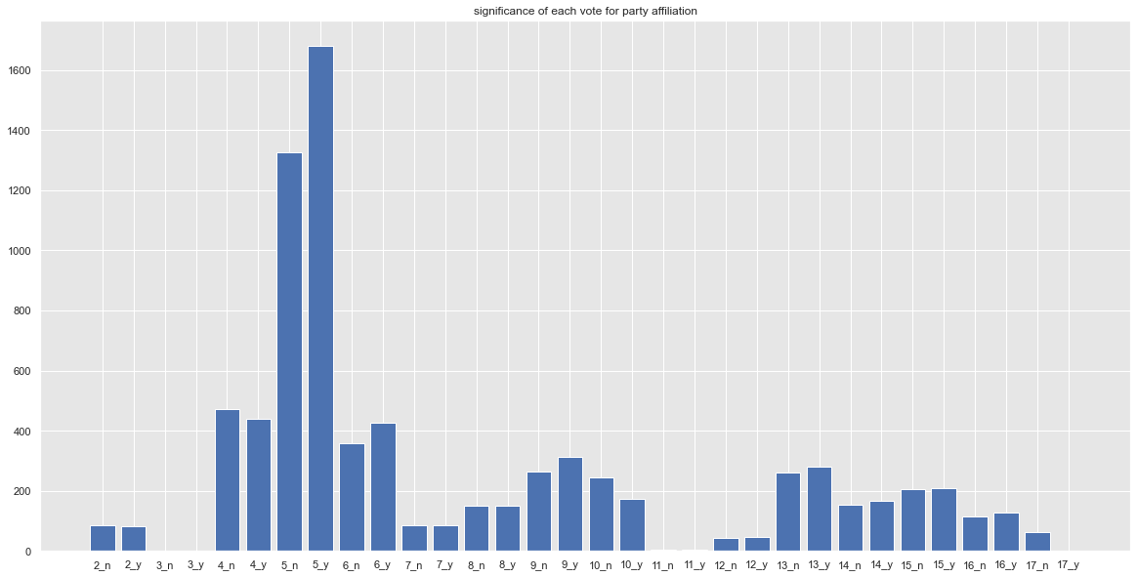
Visualise – Select K-Best

Slide 8
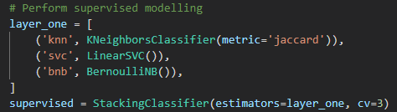

Which models to use?
For supervised, Stacking, as per requirements. We will stack KNN, SVC, and Bernoulli Naive bayes, with logistic regression as the final estimator
On the same principle, we will use an extra unsupervised algorithm - K-Means clustering, assuming that party members will cluster together in votes

Slide 9
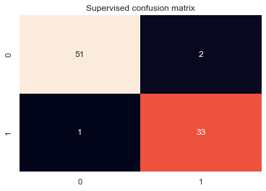

Supervised Results
Model accuracy on TEST data:
0.9655

Slide 10
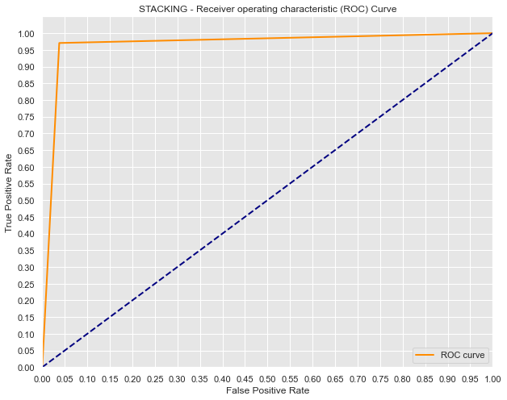

Slide 11
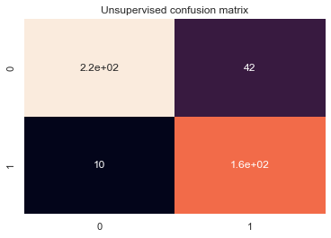
Unsupervised Results
Model accuracy on TEST data:
0.8805

Slide 12
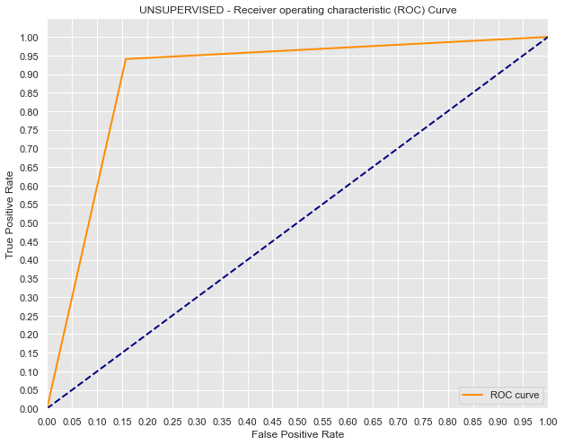

Slide 13
Discussion
With our stacking estimator, we were able to get very good accuracy in classifying Republicans and Democrats, just according to their voting record
The unsupervised method also showed quite a high accuracy, demonstrating that the parties can be grouped together on their votes with no foreknowledge of their affiliations

Slide 14
Applicability
By identifying the members who consistently fall outside of the groupings, we could identify politicians with views and voting records contrary to their stated affiliation
Separation may break down if we include more and more bills and policy decisions that were not selected for their ‘importance’

